Slide 1
What this class is about:
An overview of how the Internet works
What is a website and how to create one from scratch
...with semantic markup and design/layout
...with interactivity through client- and server-side programs
...with up to four different languages
...by searching through online documentation
...and by following detailed specifications
...and overall, building design/development strategies across the "full-stack"
The end result? A better understanding of the web, important technologies, and a portfolio for you to show!

Slide 2
What this class is *not* about:
While this course is very practical and hands on (you will write lots of code and be able to show it off), it is a foundational survey course.
This means:
… you will learn the foundations of what powers the Web, but not the latest framework everyone might be talking about.
… you will learn a lot of concepts and a lot of terminology, but there will always be more; we don't (and can't) cover it all.
… as such, while people have gotten Web programming/development jobs after this course, our goal is to give you the basis with which to learn more -- it's an intro course, after all.

Slide 3
Modules
Web page structure and appearance with HTML5 and CSS.
Client-side interactivity with JavaScript.
Using web services (APIs) as a client with JavaScript.
Writing JSON-based web services (APIs) with Node.js.
Storing and retrieving information in a database with SQLite and server-side programs.

Slide 4
Web Development Tools
Throughout the quarter, we will be using the following web development tools:
Chrome: a browser to view and debug web pages
VSCode: a text editor to write HTML/CSS/JS/SQL (with various helpful packages available)
Github to clone/push CP/HW repositories (built into VSCode)

Slide 5


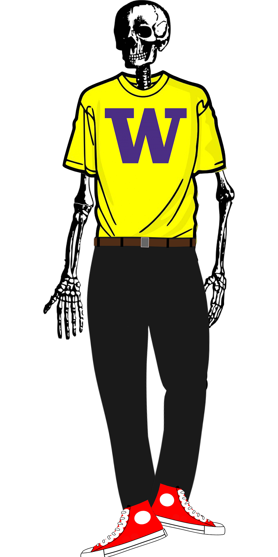
So What is a Web Page Really?
CONTENT
STRUCTURE
STYLE
BEHAVIOR

Slide 6
Ok, but what is it really?
What's everything involved here?
It's just this, right?
Decide on URL...
Type it in...
Hit enter...
Website loads!
But what happens between 3 and 4?

Slide 7
What happens in the second half?
You don't have Google.com on your computer. So, where does it come from?
Figure out where it is
Ask for it to be sent to us
Check and verify what we get
Show it

Slide 8
The thing in the address bar. Where is the website?
Uniform Resource Locator (URL): An identifier for the location of a document
A couple of basic URLs:
https://courses.cs.washington.edu/courses/cse154/22su/
https://www.gradescope.com/courses/123456
path
protocol
host

Slide 9
Protocol: is “an established set of rules that determine how data is transmitted between different devices in the same network” (source)

Slide 10
The Internet
The internet: the way computers connect to share information with each other
Communication through internet protocol suite (TCP - transmission control protocol/IP - internet protocol), set of communication protocols
Global network
“Network of networks”
Enables us to do and be able to access an immense amount of services/information
Most common use of the internet: accessing the world wide web
Other uses: email, file transfer, etc.

Slide 11
The World Wide Web
Application that runs on the internet
Collection of information we have access to via the internet
We need the internet to access the world wide web

Slide 12
Internet VS. The Web
INTERNET
Computers (servers) connected to each other via a series of networks
Powered by layers upon layers:
Physical: The cables between them
Data & Network: The [small] packets of information
Transport (TCP/IP): Providing connections and reliability
Application: Tying everything together to be useful
THE WEB
Collection of pages of information
Text... but with some "Hyper" around it
Pages can link to each other
Pages have style and interactivity

Slide 13
Remember that URL? (https://google.com/)
Need to go out to the internet to get the webpage.
Internet is low-level: based on numbers (IP addresses), not names.
Domain Name System (DNS)
A Domain Name System translates human-readable names to IP addresses
Example: cs.washington.edu → 34.215.139.216
Hostname of cs.washington.edu (which we might put into the browser's address bar)
... has IP address of 34.215.139.216 (which will be used to contact the server via the internet)

Slide 14
More of the URL than the host
https://courses.cs.washington.edu/courses/cse154/22su/
We've handled the host to IP address (so we know who to ask for the web page)
The "protocol" tells us how:
HTTP: HyperText Transfer Protocol
Gives us the instructions (protocols) for how to share (transfer) web content ("hypertext")
And the rest tells us what:
From the courses.cs.washington.edu server (aka host)...
I'd like the thing called courses/cse154/22su/… (aka path or resource)

Slide 15
HTTP codes
With all responses that a web server sends, there is a response code which signifies the status of the response
Common Codes:
Number | Meaning
200 | ok
301-303 | Page has moved (permanently or temporarily)
403 | You are forbidden to access this page
404 | Page not found
418 | I’m a teapot (fun fact, example)
500 | Internal server error
Complete list (as dogs, as cats)

Slide 16
The real innovation
HTTP built resilience into the internet by creating the 404.
A website will always give a response, even if what a user wants isn't found.
Examples:
ACM’s 404
WSDOT
Imgur
FT Labs
Discord
Android
GitHub

Slide 17
Then… we have the web page right?
WORDS + IMAGES
HTML
CSS
JAVASCRIPT

Slide 18
What’s in a web page
Hypertext Markup Language (HTML): semantic markup for web page content
Cascading Style Sheets (CSS): styling web pages
Client-side Javascript: adding programmable interactivity to web pages
Asynchronous Javascript and XML: fetching data from web services using JavaScript fetch API
JavaScript Object Notation (JSON): file format for organizing human readable data

Slide 19
A brief introduction to HTML

